Slide 1
MOAT ACADEMY
WEB APPLICATION DEVELOPMENT TRAINING
CSS Positioning – Day 4

Slide 2
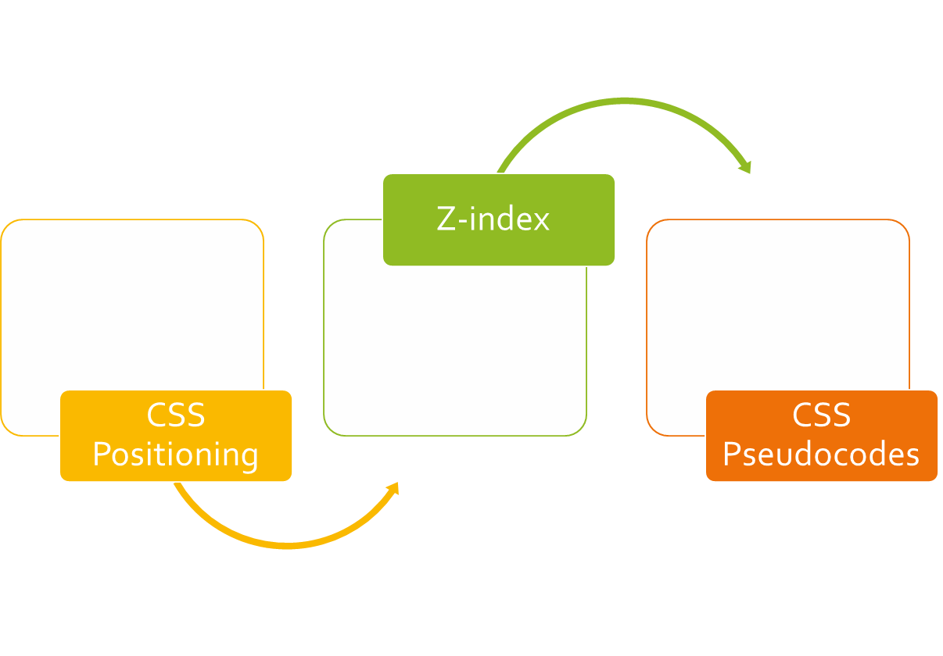
CLASS
OUTLINE

Slide 3
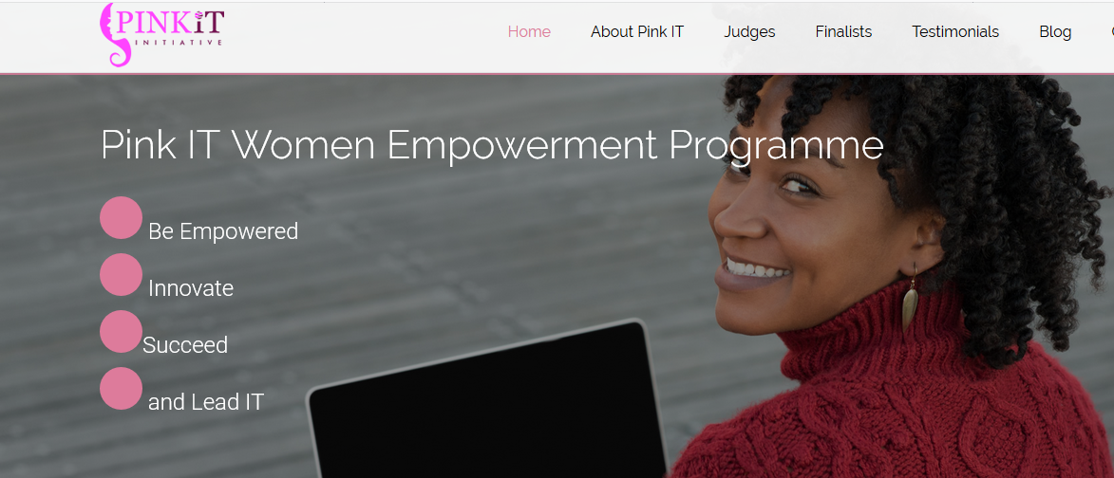

Slide 4
CSS POSITIONING

Slide 5
Positioning rules
Sometimes you just want an element to appear at a particular distance from the edges.
Float will only help you move your divs left or right
You can then specify to the elements where on the page they should appear. (top, bottom, left, or right)
But first, you determine the kind of positioning rule the element(s) should obey through the positioning property**
This specifies how the elements of the webpage should be placed, values may be fixed, static, relative, absolute or sticky
Notes:
Top, right, left or bottom will not work if positioning is not set. These will not have effect on statically positioned elements

Slide 6
Setting the Positioning
Static : This is the default, if an element is not positioned explicitly, then its statically positioned.
Relative: relative to its “normal” position, other contents will not take any gap left by it.
Fixed: relative to the viewport, which means it always stays in the same place even if the page is scrolled. Does not leave gap in the page where it would have been created.
Absolute: positioned relative to the nearest positioned parent, if no parent, uses the body

Slide 7

Sticky Positioning
A stickily positioned element is treated as relatively positioned until it crosses a specified threshold, at which point it is treated as fixed until it reaches the boundary of its parent.
Sticky positioning can be thought of as a hybrid of relative and fixed positioning.
You must specify a threshold* with at least one of top, right, bottom, or left for sticky positioning to behave as expected. Otherwise, it will be indistinguishable from relative positioning.
Notes:
The threshold is concerned about: as we scroll the page… and the element in question scrolls up at what distance from the top should it become fixed? Same thing applies to other edges

Slide 8
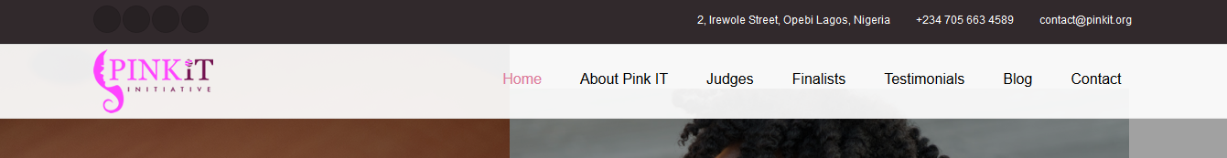
Sticky Positioning in Practice
Notice the black background before the sticky menu, it ensures that we scroll the page up to the point specified before the menu becomes fixed
Notes:
You must specify a threshold with at least one of top, right, bottom, or left for sticky positioning to behave as expected. Otherwise, it will be indistinguishable from relative positioning.

Slide 9
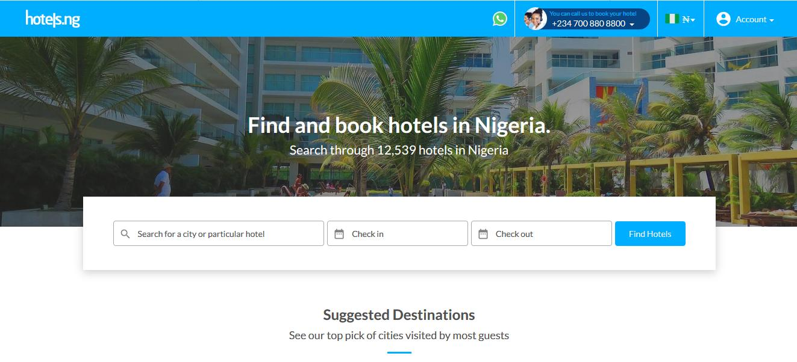
Sticky Positioning in Practice
Notice that the search box is at some distance from the top of the page

Slide 10
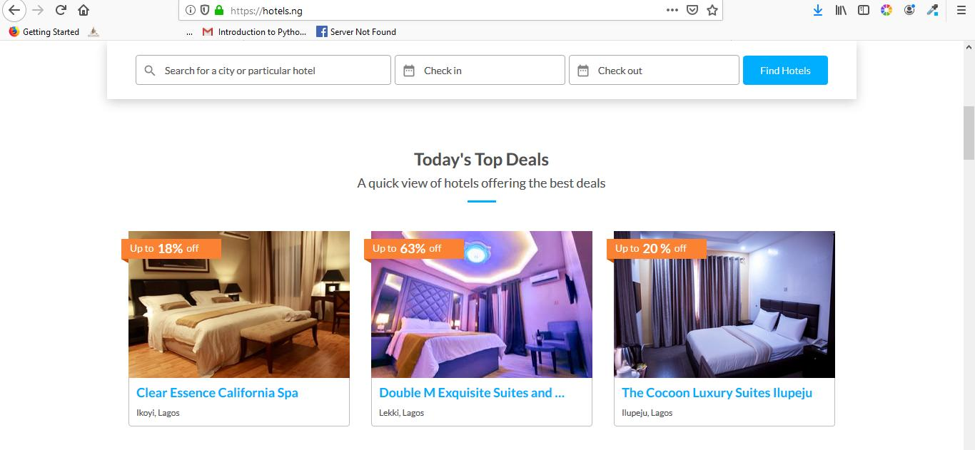
Sticky Positioning in Practice
On scrolling the page, when the search box gets to a distance of 0p from the top
From the viewport, it becomes fixed

Slide 11
Notes on Positioning
If both top and bottom are specified (technically, not auto), top wins.
If both left and right are specified, left wins when direction is ltr (English, horizontal Japanese, etc.) and right wins when direction is rtl (Persian, Arabic, Hebrew, etc.)

Slide 12
The z-index
Specifies the stack order of an element (when placed on top of each other)
! Remember that an element is placed on top of each other by positioning them so
An element can have negative or positive z-index value.
The element with a higher z-index comes on top of the others
The element must be positioned before it can respond to z-index;
Practical Application: Drop-down menu.

Slide 13
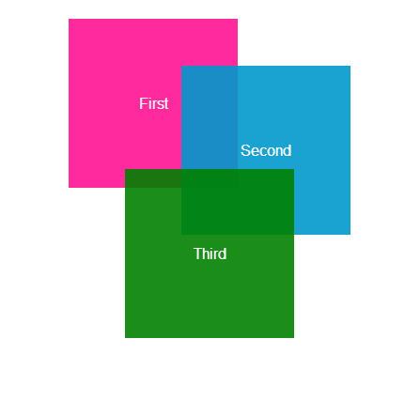
Achieve the stack shown using positioning:
Hint: z-index, positioning
Hint: Position the elements such that they almost appear in the same location. Then use z-index to arrange them, baby pink: rgb(244,194,194)

Slide 14
HANDSON

Slide 15

Google Interface

Slide 16

Search Bar with Background

Slide 17
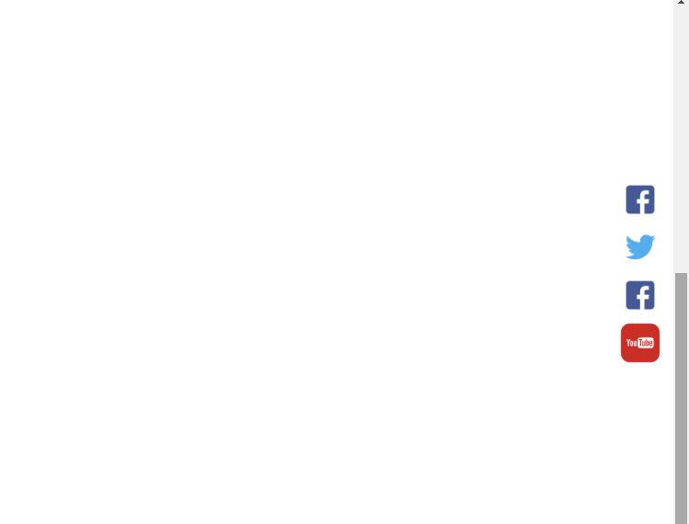
Fixed Social Media Side Bar

Slide 18
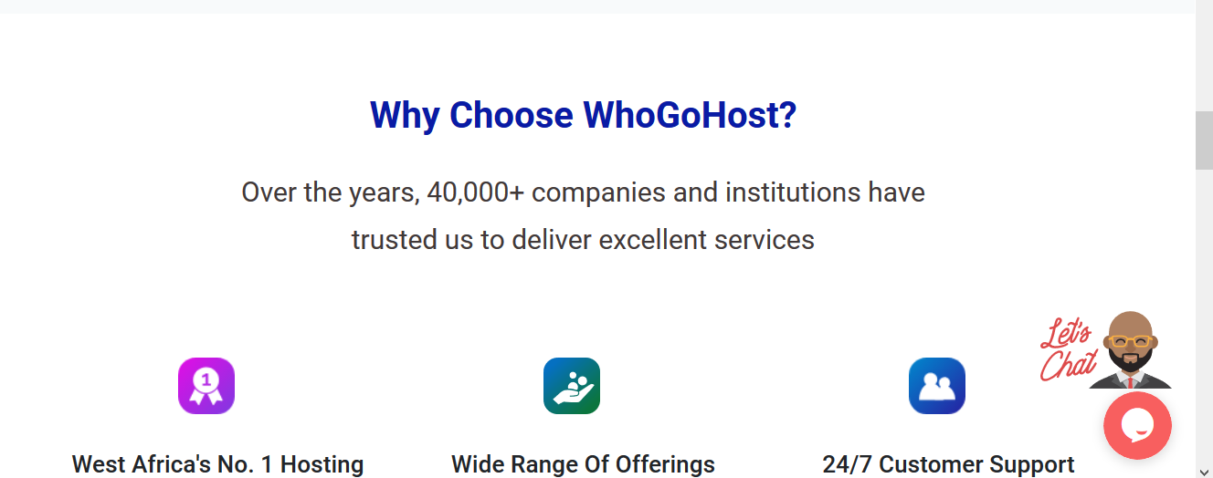
The LiveChat Icon is not moving with the page as it scrolls….

Slide 19
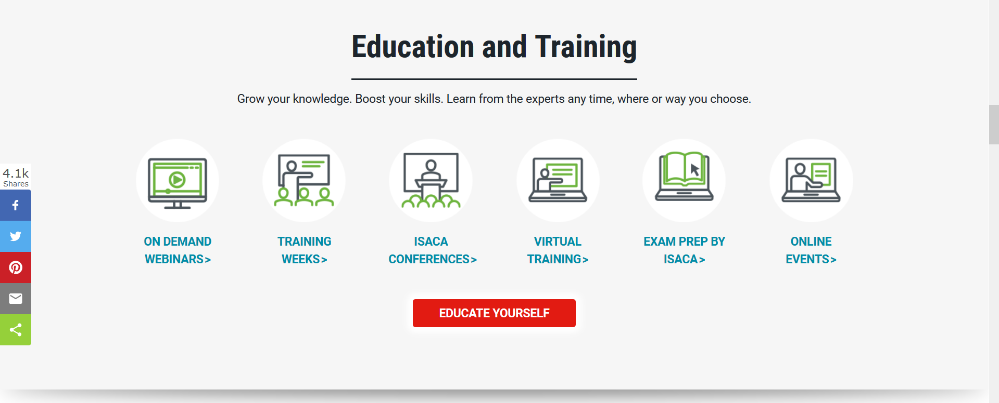
The social media div is not moving with the page as it scrolls….

Slide 20

Collapsible Header
Notes:
A div positioned absolutely in another div that has background image.
Step two: turn to a collapsible header by giving the background-attachment: fixed

Slide 21
Other CSS Pseudo classes
Pseudo classes are used to style specified parts of an element. For example, the beginning part of an element, elements when they are selected etc

Slide 22
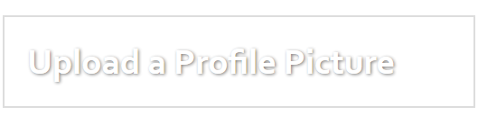
Other CSS Properties
The text-shadow property applies shadow to each of the character in the text, Internet Explorer 9 and earlier versions, do not support the text-shadow property.
Syntax: text-shadow: horizontal amount vertical amount blurr amount color eg 2px 3px 6px red;
You can combine multiple shadow in one line by separating the h v b color with comma (see notes for example)
The box-shadow property applies shadow to elements. Syntax is like that of text-shadow. Example: box-shadow: 10px 10px 5px grey;
Notes:
h1{
box-shadow:3px 3px 5px red, 6px 6px 5px blue ;
}
h1{
text-shadow:1px 1px 2px grey;
color:white;
border:2px solid #ddd;
padding:20px;
width:35%;
}

Slide 23
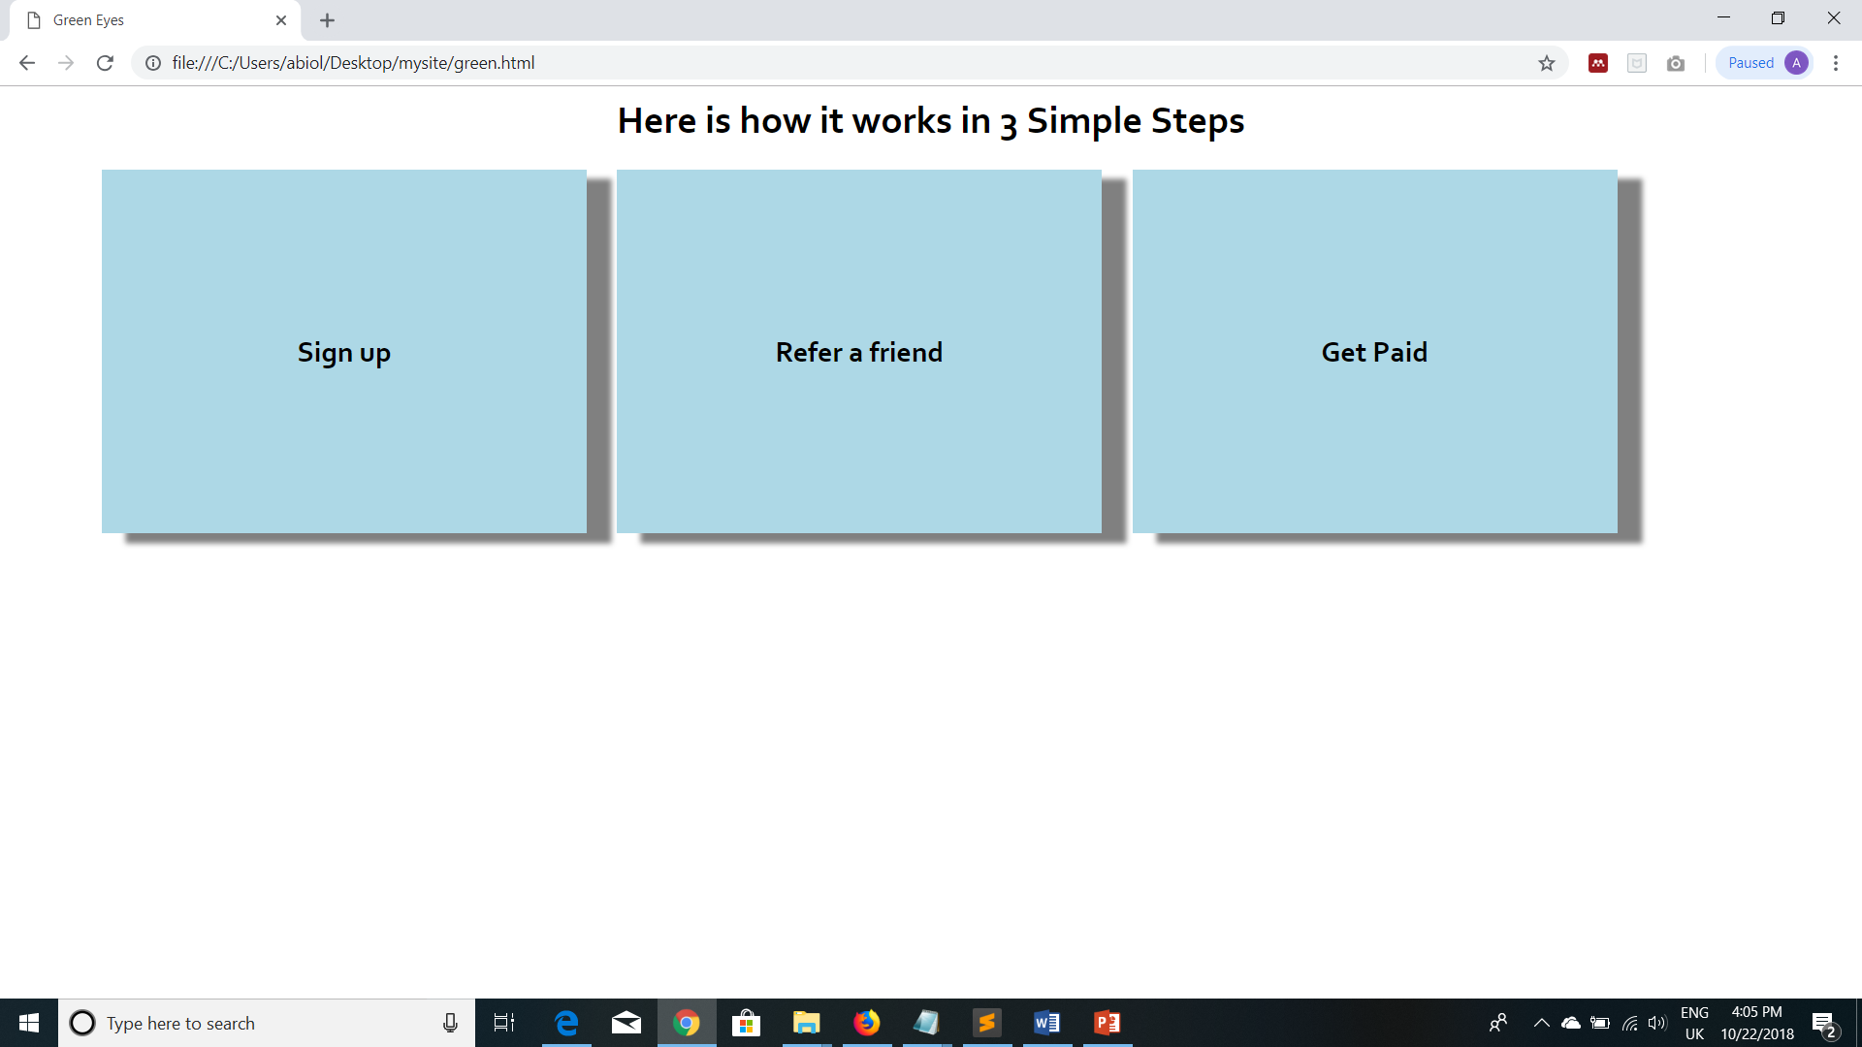
Classwork: Using box-shadow property, achieve something similar to this >

Slide 24
Other CSS Properties: Pseudo Classes
Pseudo classes are used to style specified parts of an element. For example, the beginning part of an element, elements when they are selected etc
General Syntax is: selector::pseudo-element {
property:value;
}
::first-line, ::first-letter
::before and ::after can be used to insert some contents before and after the content of an element.
Syntax is selector::before{content: url(‘’)}
::selection pseudo-element matches the portion of an element that is selected by a user.
input[type='button’] to apply css styles to the specified input type

Slide 25
The hover state
General Syntax is:
selector:hover {
property: value;
}
The hover pseudo-selector is used to target an element in its hover state, that is: when the user mouses over the element.
It can be applied to any element * but it’s usually applied to the <a> tag to specify different rules based on the state of the link.
In addition to the :hover state, the <a> tag responds to other states such as :active, :link, :visited.
:hover MUST come after :link and :visited (if they are present)
Notes:
tr:hover {/* rule for when the table is moused over */}
img:hover {/* rule for when the image is moused over */}

Slide 26
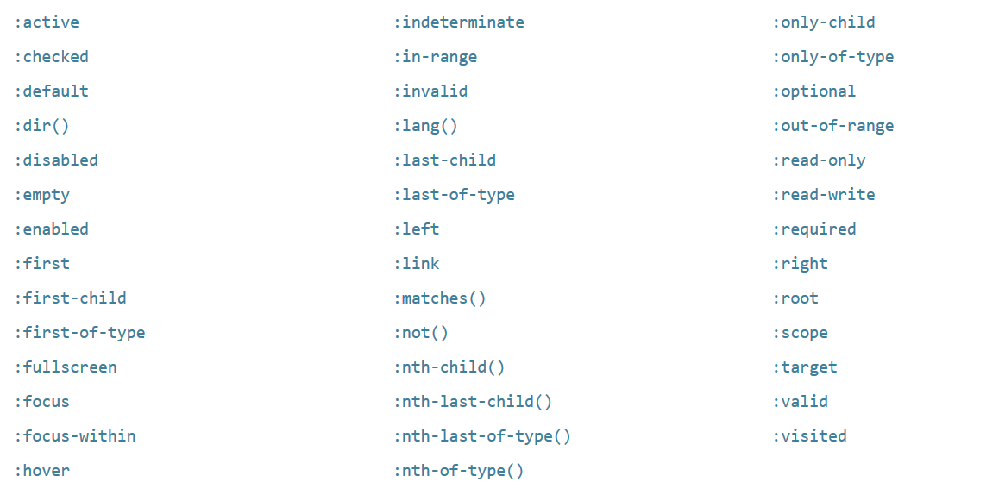
Go Further!
Check out other pseudo classes

Slide 27

A corporate organization has been having series of meeting on how they can increase their website traffic

Slide 28
Week Two Mini project
You have been approached as a web designer to help re-design their current website to be beautiful and SEO friendly so that they can attract more customers
Useful resources:
  http://coolors.co for color mix
  http://fontpair.co to get fonts
  https://www.flaticon.com/ to get icons
  https://pixabay.com to get free HD images

Slide 29
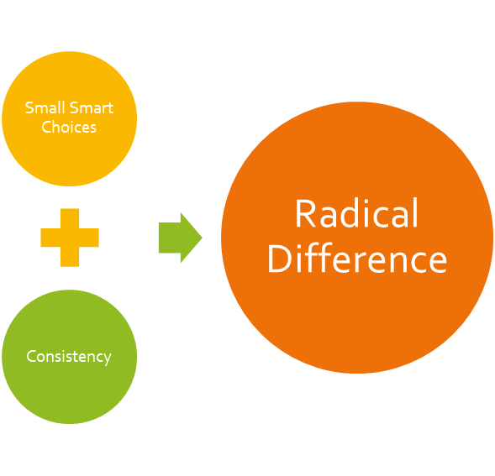
Catch up with all outstanding!
Well done, we are getting there…

